Slide 1
Change Validation in Monitoring Document Complement
P0225097 (C0024568)

Slide 2
Problem’s Detail
Description of Changes
When user wants to change police number in menu Monitoring Document Complement, after user click ‘Save’ button, there will be error message:
“We are Sorry! Something happen with your application, please contact Administrator, thank you. { Additonal message : "Object reference not set to an instance of an object." } “
If we refresh the menu and search for the unit, it will be not found in new police number and the old police number.

Slide 3
Problem’s Detail
Root Cause
When update police number, the code will check whether the unit have DocValue 2 (KEUR). If unit don’t have DocValue 2, then it will show error message and police number in tb_mgt_historydoc will not changed to new police number but in tb_opl_unit & opluobjectlease, police number will changed to new police number.
Different Police Number in TB_OPL_Unit, Opluobjectlease with Tb_mgt_historydoc will caused the unit cannot be searched in Monitoring Document Complement.
Fixing
Change code that don’t need to check DocValue 2, because there are units that don’t have KEUR document.

Slide 4
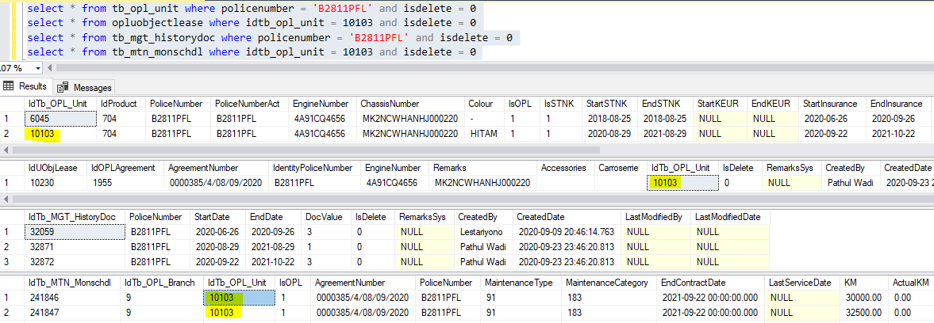
Before
This is database condition before change police number. When police number changed, all police number field in tb_opl_unit, opluobjectlease, tb_mgt_historydoc and tb_mtn_monschdl should be changed to new police number.
As we can see, in table TB_MGT_Historydoc there is no DocValue 2, only 1(STNK) and 3 (Insurance).

Slide 5
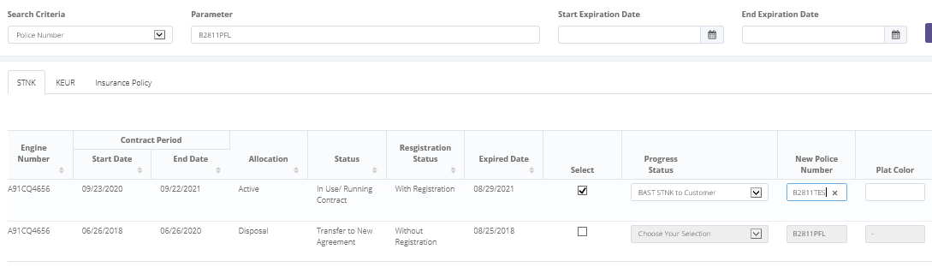
Before
The scenario is to change new police number for unit B2811PFL to B2811TES.

Slide 6
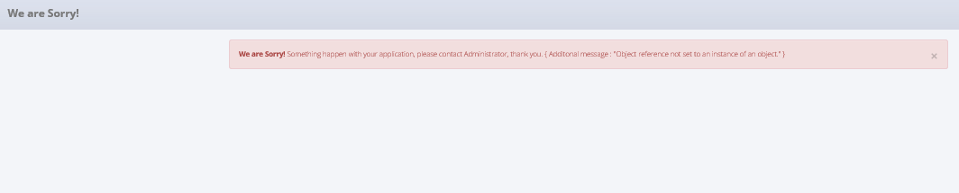
Before
After click save, system will show Error Message:
“We are Sorry! Something happen with your application, please contact Administrator, thank you. { Additonal message : "Object reference not set to an instance of an object." } “

Slide 7
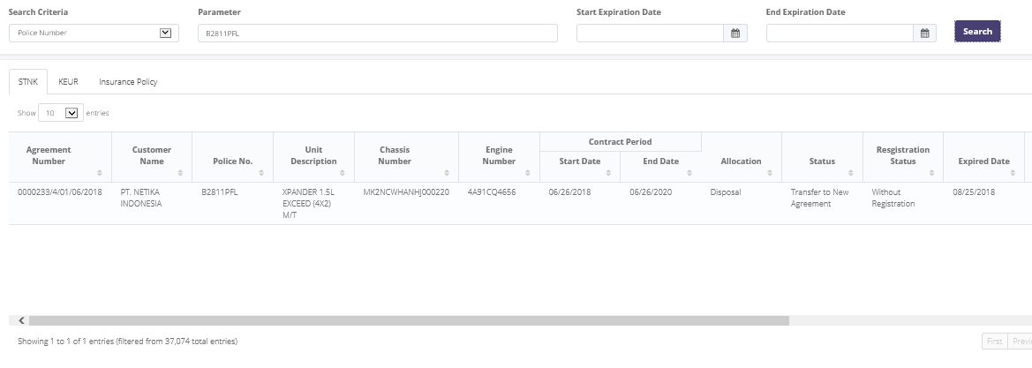
Before
If we search the old police number, it will only show the old agreement. Unit in new agreement not show.

Slide 8
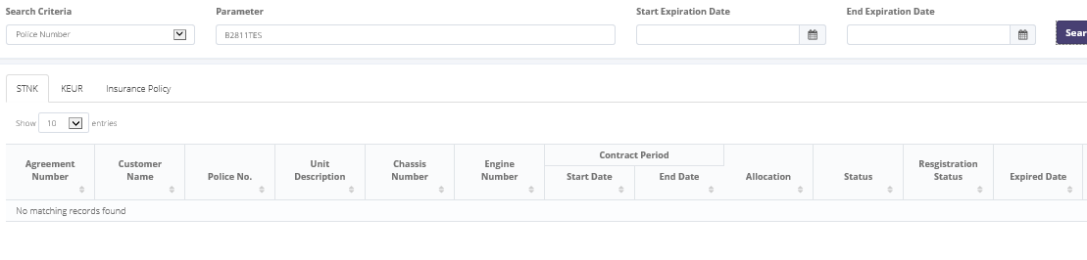
Before
If we search the new police number, it will show No Matching Records Found

Slide 9
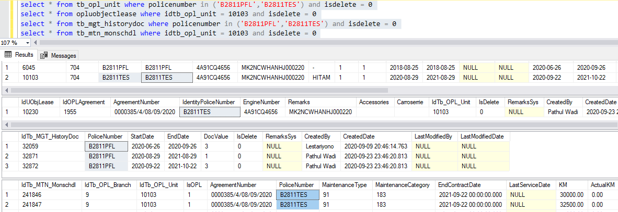
Before
This is database condition after new police number saved. In tb_opl_unit, opluobjectlease and tb_mtn_monschdl, police number changed to new police number (B2811TES). But in tb_mgt_historydoc, police number not change to new police number.

